Slide 1
HOW DO INDIVIDUALIST AND COLLECTIVIST IDEALS INFLUENCE INVESTOR SAY-ON-PAY VOTES FOR COMPANIES
Candy, Karl, Marcos, Nicola
Notes:
Hello everyone, representatives from UVA, Lingnan and ESADE and welcome to the defense of “How do individualist and collectivist ideals influence investor say-on-pay votes for companies” by Candy, Karl, Marcos, and Nicola

Slide 2




Agenda
Motivation & Theory
Method & Experiment
Analysis & Findings
Conclusion & Limitations
Notes:
Starting off, our agenda for the day is as follows:
First we will talk about our motivation and research.
Next, methodology.
Following that analysis and our findings.
And finally to wrap it all up, the applications and limitations of our research.
---
Icons from flaticon.com

Slide 3

Motivation & Theory
Notes:
First, we’d like to go over our motivation to study this topic and the research we have done.

Slide 4



Motivation For The Study
High CEO-to-Worker Pay Gap
US Adopted Say-on-Pay
The Role of Cultural Dimensions
Notes:
Why individualism and say-onpay?
Individualism is one of Hofstede’s four cultural dimensions and it has been shown to be related to overall CEO pay levels by Tosi and Greckhamer. Is this because individualist people are more tolerant of inequality (in the business sense)?
Additionally, we have noticed that in today’s world, the ratio of CEO pay has become an important topic within the public view. Due to this, we wanted to study say-on-pay votes, as they allow investors to voice their opinions of CEO pay in a non-binding vote.
Furthermore, the shareholder base of public companies is becoming always more international and during the last 30 years many studied followed the hoefstede stream of research analyzing how cultural dimensions influence society and individuals.
This leads us to a simple question: Does individualism moderate investor opinions?

Slide 5

Research Planning
To understand what is known about this topic, we defined 3 main areas of research:
Agency Theory
CEO Pay Practices
Hofstede’s Cultural Dimensions (Individualism)
Notes:
To start off our research, we defined 3 main areas to explore:
Agency theory
CEO pay practices
Hofstede’s cultural dimension of individualism

Slide 6

Agency Theory
Compensation is an incentive to align managerial interest to shareholders. (Fama & Jensen, 1983; Holstrom, 1979; Jensen & Murphy, 1990)
CEOs set their own compensation, or at least are influential in compensation setting process. (Tosi & Gomez, 1989; Williams, 1985)
CEO compensation becomes an agency problem itself when it is too high. (Boivie, Lange, McDonald, & Westphal, 2011)
Notes:
First, agency theory as it relates to CEO pay, and we see that CEO compensation does have an important purpose.
CEO compensation can be thought of as an incentive to align managerial and shareholder interests, attempting to eliminate the principal-agent problem.
Now, CEOs are, at minimum, influential in the process of designing their own compensation package. This can evolve into an agency problem itself if compensation levels grow too high while firm performance does not.

Slide 7

CEO-to-Worker Pay Ratio
Pay ratio has risen from 125:1 in 1992 to 380:1 in 2016. (Mishel & Sabadish, 2012; Sahadi, 2007)
Shareholders always prefer the lowest possible CEO pay. (Krause et al., 2014)
Say-on-Pay voting dissent rises tremendously as pay ratio increases. (Alissa, 2015; Crawford, Nelson, & Rountree, 2017)
Notes:
Second, CEO-to-worker pay ratios, which present a possible problem.
In the past 24 years, the ratio of CEO pay has tripled from 125:1 all the way to 380:1.
This brings into light a potential conflict, as Krause et al. notes that shareholders always prefer lowest possible CEO pay, given a fixed level of firm performance.
Perhaps due to this is why we see that say-on-pay dissent is much more common as the CEO pay ratio increases.

Slide 8

Hypothesis 1
CEO to average employee pay ratio is negatively correlated with investor Say-on-Pay approval.
-
CEO to Employee Pay Ratio
Investor Say-on-Pay Approval
Notes:
This brings us to our first hypothesis, that CEO to average employee pay ratio is negatively correlated with investor say-on-pay approval.

Slide 9

Culture
Individualism emphasizes “I” while collectivism focuses on “we”. (Hofstede, 1984)
Individualist cultures believe those at the top should be rewarded accordingly. (Hofstede, 1980)
Applying national culture to individuals is not accurate. (Yoo et al., 2011)
Notes:
Culture dimension have been studied broadly by Hoefstede that is the father of the Cultural dimension theory,
We used Indivdualism/collectivism, In fact, according to the Social Orientation Hypothesis about the origin of cross cultural differences in decision-making, all currently existing cultures can be compared with one another against the collectivism/individualism scale (Varnum, 2010).
According to Cultural Dimensions Theory author, Geert Hofstede, individualism emphasizes “I”, whereas its opposite, collectivism, focuses on “we”. A side-effect of this is that individualist cultures value meritocracy, and maintain that those individuals at the top deserve to be rewarded accordingly.
But Hofstede’s and many others research have analyzed cultural dimensions on the national level. According to Yoo et al., blindly applying the national cultural dimension score to every single individual within the country may not be accurate, especially because many societies have heterogeneous populations and high mobility of individuals.
We recognize the need to study culture on the individual level.

Slide 10

Hypothesis 2
Individualist ideals negatively moderate the relationship between CEO pay ratio and Say-on-Pay approval.
-
CEO to Employee Pay Ratio
Investor Say-on-Pay Approval
Negatively Moderates
Individualism
Notes:
This brings us to our second hypothesis, that individualist ideals [negatively] moderate the relationship between CEO pay ratio and say-on-pay approval.
We hypothesize that individualism is a main driving factor behind approval or dissent in say-on-pay votes.
INDIVIDUALISM IS A MODERATOR

Slide 11

Methodology
Notes:
Next, our methodology and our sample.

Slide 12



Sample
Survey sent out late-April
111 MBA students & alumni
Used as investor proxies¹ and to study cultural sensitivity² in previous studies (Thaler et al., 1997¹; BHAWUK & Brislin, 1992²)
Notes:
Our sample will consist of MBA students from all three universities (UVA, ESADE, and Lingnan), additionally some from other universities.
We chose MBA students, as it will be much easier for us to include them in our experiment than getting several hundred investors to do so.
MBA students have long been used as proxies for investors in many studies according to Thaler et al., and have been proven to be sophisticated in making educated business decisions. Additionally, Bhawuk & Brislin’s 1992 study (among others) uses MBA students to study cultural sensitivity.
Cleaned 5 of 111 respondents -> ending sample size of 106

Slide 13
Quasi - Experimental Design
01
Firm Scenario and Say on Pay Vote
02
Culture Scaling
03
Screening & Demographics Questions
Notes:
Our sample of MBA students will receive a survey that we developed to gather the information we need.
The survey is broken down into 3 parts:
The first section present the respondents with a scenario of a hypothetical firm during an annual meeting and will prompt them for either their approval or dissent on a say-on-pay vote.
The second section contains questions about the individualistic or collectivistic ideals of our respondents. All questions are marked on a scale from 1 to 5.
The third and final section consist in screening and demographics questions. [insert more about screening questions and booting people from the survey].

Slide 14
Quasi - Experimental Design
CEO-to-Worker Pay Ratio
Respondents randomly assigned to one of two different groups.
High Scenario
(+20%)
Low Scenario
(-20%)
Notes:
To ensure the validity of our study, all respondents will be randomly assigned to one of two different groups.
The only variables that we will be changing between each survey are the ratio of CEO to worker pay.
Average ratio is 361:1 (AFL-CIO, 2018)
High scenario is 20% above
Low scenario is 20% below
Hypothetical firm performance will be controlled (Tversky and Kahneman, 1991; Krause et al., 2014)
Firm performance will be set at average S&P 500 annual return rate, 10% (Investopedia, 2018)
No mention of equity to cash ratio

Slide 15
Variables
Controls:
Region
Gender
Age
Income
Investment
Public Corporation
CEO/Founder
Dependent:
Say-on-Pay approval
Independent:
Pay Scenario
Moderator:
Culture
Notes:
4.3 Dependent Variable
Say-on-Pay approval. Say-on-Pay approval is measured by voting for or against the CEO to average employee pay ratio. Respondents have to make the vote after they read the material in the assigned scenario. We coded approval as “1” and disapproval as “0”.
4.4 Independent Variables
Pay Scenario. We have both a high pay and a low pay survey in our study. To better analyze our survey results, we aggregated the survey data, in which we coded the different scenarios as binary data: the high pay scenario as “1” and the low pay as “0”.
Individualism. In most of the past studies, participants are categorized based on the individualist and collectivist inclination of their country rather than their own, which may bias the test result since additional research shows people can vary ideologically within the same country or culture. Yoo et al. (2011) notes that this is an important consideration to take into account. Different from most of the existing studies, we are categorizing our respondents in terms of individualist and collectivist dimensions on the individual level rather than at the national level to make our experiments more accurate. We calculated this variable by summing up respondents CV scores, as this is the standard for likert data according to Boone et al (2010). As data was skewed towards more collectivist, we decided to classify respondents as either individualist or collectivist based on their summed Culture Score in relative relation to the midpoint of our culture score data. 0 being collectivist and below the midpoint of the data, whereas 1 is individualist, and above the midpoint.
4.5 Control Variables
To better isolate the theoretical relationships that we propose, we include a set of control variables on individual factors into the quasi-experiment model. A previous study regarding the relationship between CEO compensation and culture that we analyzed contained no control variables, due to the data coming from a dataset (Schuler & Rogovsky, 1998). Furthermore, other studies regarding the same relationship (Bryan, 2012) only control for determinants of compensation structure. We controlled compensation structure in our experiment by keeping the ratios equal across our surveys. Regardless of the fact that studies did not control for other potential demographic moderators, we brainstormed and identified several variables that could influence an individuals Say-on-Pay vote, and controlled for them by creating the control variables below. While this is not an exhaustive list of all the possible demographics to control via variables, it does cover the major characteristics of an individual that have the potential to influence their vote. Additionally, it is not possible or feasible to control for every possible demographic-related influence, especially given quasi-experiment methodology and our desire to keep our survey concise and straightforward. Below are the control variables that we used. However, in the course of our analysis, none of the control variables we included in our models was statistically significant in helping us determine the approval of Say-on-Pay votes. Perhaps this was due to our small sample size.
Nationality. We provided 3 questions on our survey to measure Cultural Identification: Country of Birth, Nationality, and Country most Identified with. We selected Country most Identified with as an independent variable for analysis, as our hypothesis requires measuring cultural identity. We included the aforementioned variables to be controlled, as Hofstede (1984) notes that there are real differences between major cultures. Identity itself is a personal perception, and this rationalized our selection of this specific response as our variable. In the vast majority of our responses, Country most Identified with was the same as the Country of Birth or the Nationality of the respondent. After this, we grouped respondents into 4 regions for simplicity: North America, Latin America, Europe, and Asia to use as control variables.
Gender. Research has shown that there is substantial difference between men and women in in-group bias, which is the preference others of the same gender. In Rudman et al. (2004), it was shown that women’s in-group bias is significantly stronger than that of men’s. In addition, Eckel et al. (1998) demonstrated that women a far less selfish than men. Due to these gender related differences, we recognized the need to control for Gender, as our sample included both men and women, and the CEO in our hypothetical scenario was male. We asked our respondents for their gender, providing 3 options: Male, Female, and Other/I Prefer not to Respond. Upon analysis, we did not have a single respondent who selected the third option, and as such, we were able to simply use Male and Female as binary data for our control variable.
Age. Previous research has proposed that there are differences in attitudes among different age groups. Quintelier (2007) indicated that each stage of life holds differing social inclinations because of differentials in resources, experience, and occupation of different social roles. As such, we recognized the need to control for age. We gave our respondents 5 choices for age: under 21, 21 to 24, 25 to 28, 29 to 32, and above 32. Each range is equally spaced, and centers around the age ranges that an MBA student would most likely fall into, as they were our primary target. Additionally the upper and lower bound options include all ages above, and below (respectively) in order to track all respondents.
Income. We suspected that those with greater income and wealth would have a different perception of fairness than those with less. Indeed this is the case, as research conducted by Armantier (2006) suggests that relative differences in wealth seem to reshape one’s concept of fairness. To account for this, we gave our respondents 5 choices for income: less than $29,999, $30,000 to $59,999, $60,000 to $89,999, $90,000 to $119,999, and greater than $120,000. Each range is equally spaced, and covers the all income possibilities. This variable aims to verify whether an MBA student has sufficient financial ability to make investments.
Investment. Similar to the Income control variable, we included a control variable to measure Investment. We classify investments as another form of wealth, using Armantier (2006) study as a reason to include the Investment control variable. Additionally, those with investments theoretically should have a greater understanding of investor responsibilities. This variable is to measure whether the respondent has investment experience. They are provided with 5 choices: greater than $30,000, around $30,000, unsure, less than $30,000, and no investment.

Slide 16
Data Analyses
Notes:
Next, our methodology and our sample.

Slide 17

Descriptive Statistics

Slide 18


Descriptive Statistics: Average Respondent
Collectivist
Above 29 years old (71%), Student of UVA, Lingnan or ESADE
15 is the Average Score on the CV Scale
MBA Student
Investments above $30,000 (40%)
Male (63%), Worked in a Public Corporation (55%), Income over $60,000 (56%)
Low Level Investor
Upper Middle Class Male
North America (36%), Latin America (24%), Asia(27%), Europe (13%) *High Pay Scenario
International Sample

Slide 19
 | High Pay Survey |  |  |  |  | Low Pay Survey
Variables | Mean | Median | Standard Deviation | Min | Max | Mean | Median | Standard Deviation | Min | Max
Vote | 0,527 | 1 | 0,504 | 0 | 1 | 0,666 | 1 | 0,476 | 0 | 1
Individualist | 0,527 | 1 | 0,504 | 0 | 1 | 0,470 | 0 | 0,504 | 0 | 1
Total Culture Score | 15,236 | 16 | 3,977 | 6 | 23 | 14,275 | 14 | 3,821 | 7 | 22
Hofstede Ranking | 45,737 | 46 | 22,509 | 13 | 91 | 44,933 | 38 | 25,519 | 12 | 91
North America | 0,363 | 0 | 0,485 | 0 | 1 | 0,471 | 0 | 0,504 | 0 | 1
Latin America | 0,236 | 0 | 0,429 | 0 | 1 | 0,098 | 0 | 0,300 | 0 | 1
Asia | 0,273 | 0 | 0,449 | 0 | 1 | 0,274 | 0 | 0,451 | 0 | 1
Europe | 0,127 | 0 | 0,336 | 0 | 1 | 0,157 | 0 | 0,367 | 0 | 1
Gender (Male) | 0,636 | 1 | 0,485 | 0 | 1 | 0,628 | 1 | 0,488 | 0 | 1
Age from 29 to 32 | 0,364 | 0 | 0,485 | 0 | 1 | 0,333 | 0 | 0,476 | 0 | 1
Age above 32 | 0,382 | 0 | 0,490 | 0 | 1 | 0,353 | 0 | 0,483 | 0 | 1
Worked in a Public Corporation | 0,546 | 1 | 0,503 | 0 | 1 | 0,549 | 1 | 0,503 | 0 | 1
Income under 29,999 | 0,127 | 0 | 0,336 | 0 | 1 | 0,177 | 0 | 0,385 | 0 | 1
Income from 30,000 to 59,999 | 0,236 | 0 | 0,429 | 0 | 1 | 0,333 | 0 | 0,476 | 0 | 1
Income from 60,000 to 89,1000 | 0,164 | 0 | 0,373 | 0 | 1 | 0,215 | 0 | 0,415 | 0 | 1
Income from 90,000 to 119,1001 | 0,200 | 0 | 0,404 | 0 | 1 | 0,098 | 0 | 0,300 | 0 | 1
Income above 120,000 | 0,273 | 0 | 0,449 | 0 | 1 | 0,176 | 0 | 0,385 | 0 | 1
Investments above 30000 | 0,418 | 0 | 0,498 | 0 | 1 | 0,392 | 0 | 0,493 | 0 | 1
Notes:
n=56 n=51 Source: Qualtrics

Slide 20

Bivariate Correlation

Slide 21
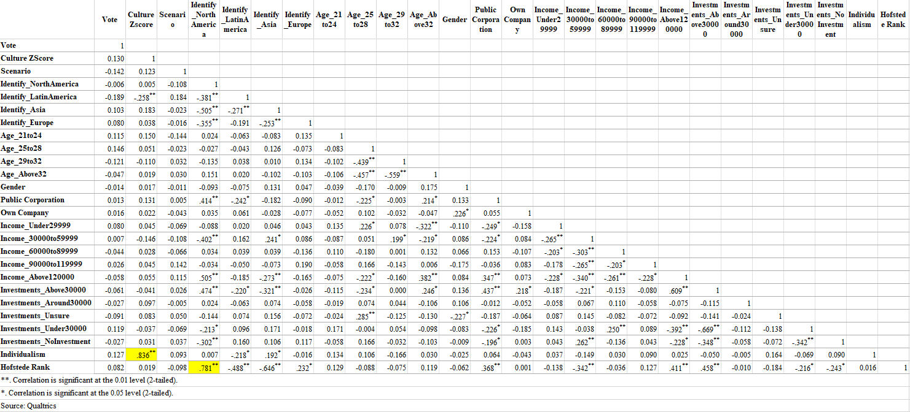
Notes:
Bivariate correlation test
Identify multicollinearity

Slide 22
Pearson Correlation Results
Negative correlation (-0.142) between pay scenario & investor Say-on-Pay approval (H1)
Positive correlation (0.130) between individualist ideals & investor Say-on-Pay approval (H2)
-
Investor Say-on-Pay Approval
Investor Say-on-Pay Approval
CEO to Employee Pay Ratio
Investor Say-on-Pay Approval
Negatively Moderates
Individualism

Slide 23

Pearson Correlation Results Cont.
A high degree of relationship (>0.85) between variables can be seen as severe multicollearity (Schroeder et al., 1990)
No correlation coefficient >0.85
Two coefficients are around 0.80
Standardized culture score with individualism (0.84)
Hofstede rank with Identify as North America (0.78)

Slide 24
Chi-square Test
Study whether there is a statistically significant difference in respondents Say-on-Pay approval between the two pay scenarios
Chi-square: t test requires the dependent variable to be continuous (Kent State University, 2019)
Significance level: 10% (Schuler & Rogovsky, 1998)
P-value: one tail (directionality) (Cho & Abe, 2013)

Slide 25
Chi-square Test
H0: Investor Say-on-Pay approval rate in the low pay scenario is NOT higher than in the high pay scenario.
H1: Investor Say-on-Pay approval rate in the low pay scenario is higher than in the high pay scenario.
 | Pearson Chi-square
Value | 2.133
df | 1
P-value (one tail) | 0.072
Reject the null hypothesis and accept the alternate

Slide 26
Logistic Regression
To determine whether low or high pay influences Say on Pay outcomes
To determine whether culture has a moderating influence on Say on Pay

Slide 27
Logistic Regression
Hypothesis 1
Hypothesis 2
Binary dependent variable Say on Pay
Binary independent variable Pay Scenario
Control variables
Binary dependent variable Say on Pay
Binary independent variable Pay Scenario
Standardized culture score
Binary culture categorization
Moderator Pay Scenario*Culture
Control variables
Notes:
These are the variables we include in each model to test our hypotheses. We conducted 5 different models to compare.

Slide 28
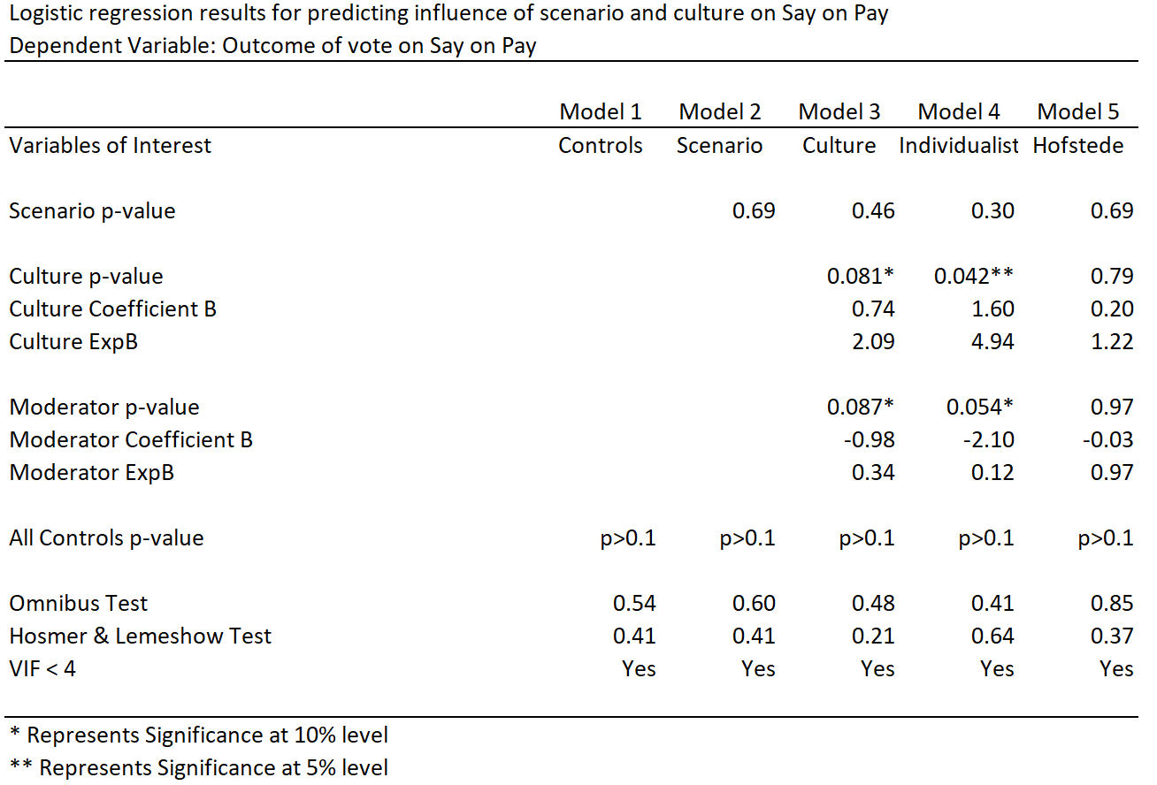
Notes:
Model 3 - Culture
Consists of the continuous variable culture score which has been standardized
Model 4 - Individualist
Categorizes each respondent into individualist or collectivist based on the standardized culture score (0 C, 1 I)
Model 5 - Hofstede
Categorizes each respondent based on Hofstede’s cultural dimensions theory (0 C, 1 I). Those with a score above 50 are Individualist. Below are Collectivist.
Model 1: No indication that controls are predictors
Model 2: Controlling for variables, no support for hypothesis 1

Slide 29
Model 3 - Culture
Pay Scenario not significant (p=0.46)
No support for Hypothesis 1
Culture is significant (p=0.081)
Positive relationship (B=0.74)
Culture odds ratio > 1 (ExpB=2.09)
+1σ Standard deviation is twice as likely, or 68% more probable to approve
Culture moderator is significant (p=0.087)
Support for Hypothesis 2
Notes:
As the culture score increases the chance for approving Say on Pay increases.
Indication that culture moderates the relationship between the pay scenario and Say on Pay, even though pay scenario relationship is not significant.
Must take a closer look at the interaction between culture and pay scenario.

Slide 30
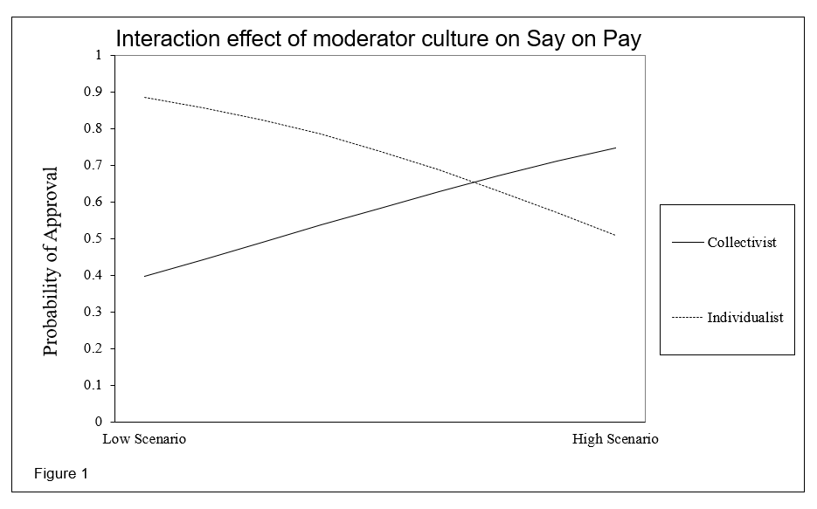
Model 3 - Culture
Notes:
In the low pay scenario an individualist has a 48% higher probability of approving CEO pay than a collectivist. In the high pay scenario a collectivist has a 24% higher probability of approving CEO pay.

Slide 31
Model 4 - Individualist
Pay Scenario not significant (p=0.30)
No support for Hypothesis 1
Culture is significant (p=0.042)
Positive relationship (B=1.60)
An individualist is nearly 5 times as likely, or 83% more probable to approve
Culture odds ratio > 1 (ExpB=4.94)
Culture moderator is significant (p=0.054)
Support for Hypothesis 2

Slide 32
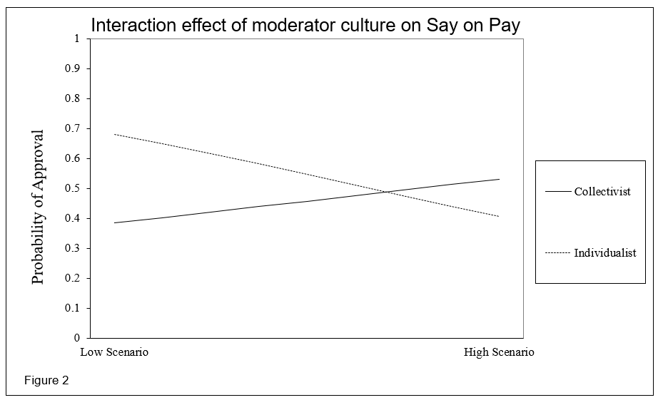
Model 4 - Individualist
Notes:
In the low pay scenario an individualist has a 30% higher probability of approving CEO pay than a collectivist. In the high pay scenario a collectivist has a 13% higher probability of approving CEO pay.

Slide 33
Model 5 - Hofstede
Pay Scenario not significant (p=0.69)
No support for Hypothesis 1
Culture not significant (p=0.79)
No relationship to Hofstede’s theory
Culture moderator not significant (p=0.97)
No support for Hypothesis 2

Slide 34

Discussion
Notes:
Where we are headed.

Slide 35
What We Found
No indication that low or high pay scenario determines Say-on-Pay approval
Indication that culture influences Say-on-Pay
Indication that culture moderates the relationship between pay scenarios and Say-on-Pay
Significant results on individual cultural level vs national level (Hofstede’s theory)
Treat results with caution
Notes:
No indication that low or high pay scenario determines Say on Pay approval
Chi-square and Pearson’s correlation suggested a possible influence
Indication that culture influences Say on Pay
More individualism increases likelihood of approval
Indication that culture moderates the relationship between pay scenarios and Say on Pay
Higher individualism = Higher approval, especially given lower ceo pay
Significant results on individual cultural level vs national level (Hofstede’s theory)
Suggests analyzing at the individual level may be more accurate
Treat results with caution
Only 10% alpha level and small sample size

Slide 36
What We Found
No indication that low or high pay scenario determines Say-on-Pay approval
Indication that culture influences Say-on-Pay
Indication that culture moderates the relationship between pay scenarios and Say-on-Pay
Significant results on individual cultural level vs national level (Hofstede’s theory)
Treat results with caution
Notes:
No indication that low or high pay scenario determines Say on Pay approval
Chi-square and Pearson’s correlation suggested a possible influence
Indication that culture influences Say on Pay
More individualism increases likelihood of approval
Indication that culture moderates the relationship between pay scenarios and Say on Pay
Higher individualism = Higher approval, especially given lower ceo pay
Significant results on individual cultural level vs national level (Hofstede’s theory)
Suggests analyzing at the individual level may be more accurate
Treat results with caution
Only 10% alpha level and small sample size

Slide 37
What We Found
No indication that low or high pay scenario determines Say-on-Pay approval
Indication that culture influences Say-on-Pay
Indication that culture moderates the relationship between pay scenarios and Say-on-Pay
Significant results on individual cultural level vs national level (Hofstede’s theory)
Treat results with caution
Notes:
No indication that low or high pay scenario determines Say on Pay approval
Chi-square and Pearson’s correlation suggested a possible influence
Indication that culture influences Say on Pay
More individualism increases likelihood of approval
Indication that culture moderates the relationship between pay scenarios and Say on Pay
Higher individualism = Higher approval, especially given lower ceo pay
Significant results on individual cultural level vs national level (Hofstede’s theory)
Suggests analyzing at the individual level may be more accurate
Treat results with caution
Only 10% alpha level and small sample size

Slide 38
What We Found
No indication that low or high pay scenario determines Say-on-Pay approval
Indication that culture influences Say-on-Pay
Indication that culture moderates the relationship between pay scenarios and Say-on-Pay
Significant results on individual cultural level vs national level (Hofstede’s theory)
Treat results with caution
Notes:
No indication that low or high pay scenario determines Say on Pay approval
Chi-square and Pearson’s correlation suggested a possible influence
Indication that culture influences Say on Pay
More individualism increases likelihood of approval
Indication that culture moderates the relationship between pay scenarios and Say on Pay
Higher individualism = Higher approval, especially given lower ceo pay
Significant results on individual cultural level vs national level (Hofstede’s theory)
Suggests analyzing at the individual level may be more accurate
Treat results with caution
Only 10% alpha level and small sample size

Slide 39
What We Found
No indication that low or high pay scenario determines Say-on-Pay approval
Indication that culture influences Say-on-Pay
Indication that culture moderates the relationship between pay scenarios and Say-on-Pay
Significant results on individual cultural level vs national level (Hofstede’s theory)
Treat results with caution
Notes:
No indication that low or high pay scenario determines Say on Pay approval
Chi-square and Pearson’s correlation suggested a possible influence
Indication that culture influences Say on Pay
More individualism increases likelihood of approval
Indication that culture moderates the relationship between pay scenarios and Say on Pay
Higher individualism = Higher approval, especially given lower ceo pay
Significant results on individual cultural level vs national level (Hofstede’s theory)
Suggests analyzing at the individual level may be more accurate
Treat results with caution
Only 10% alpha level and small sample size

Slide 40

Conclusion
Notes:
So now to wrap up our presentation.

Slide 41

Focus of Previous Literature
Hofstede’s cultural dimensions on total pay levels¹
NOT on pay perception
Cultural analysis on the national level¹ ²
NOT in the individual level
¹Tosi et al. (2004); ²Yoo et al. (2011)
Notes:
1 - Tosi et al. (2004)
2 - Yoo et al. (2011)
First, I want to look back to the beginning, primarily on the focus of previous literature. The two main points I want to highlight here are that:
Culture has been studied and its relationship to total pay levels
But this “culture” is measured using the national levels as defined by Hofstede.
Our research is different by looking at the perceptions of pay levels rather than the total, and also by looking at culture on the individual level, not the national.

Slide 42
Theoretical Applications
How individualism is correlated with Say-on-Pay approval
Culture is one of the variables that influences Say-on-Pay approval
Difference in individual and national culture
Building upon the research of:
Tosi et al. (2004)
Krause et al. (2014)
Yoo et al. (2011)
Notes:
We see our research as a platform for understanding the following:
How individualism and collectivism are correlated with say-on-pay approval
build upon tosi et al (2004) -> provide this insight
That (on a basic level), culture is one of the variables that moderates say-on-pay approval
build upon krause et al (2014) -> The team sought variables or a theory of what can influence say on pay votes, and we have shown that culture is one
There exists variation within national culture, thus individual culture may differ from national culture
build upon yoo et al (2011) -> we showed a difference on individual and national culture

Slide 43
Implications for practice
How culture affects perceptions of business practices
How individualism moderates choices
Help managers gain support of investors
Broad implications for future corporate governance practices in Asia¹
¹Gao (2004)
Notes:
When discussing the real-world implications of this research, its important to note that non-institutional investors likely dont have sufficient voting power to force a change.
However, it is still important to know how culture affects perceptions of business practices, and how individualism moderates choices in the business setting.
More importantly, it is important for managers to know how to gain the support of their investors and holds broad implications for the future.
Many chinese firms are starting to implement gov practices like those in the US (gao 2014), therefore it is important for managers to keep in mind how culture might affect perceptions of these new practices.

Slide 44

Limitations
Notes:
Finally, we are moving on to the limitations of our study.

Slide 45
Political Leanings
Potential for bias
MBA students are young
Fix by sampling real investors
Notes:
Political leanings. This is potentially a fundamental issue in sampling population that we have chosen, leading to a potential for bias.
With a target demographic that is relatively young, a problem arises in that young people typically lean to the left of the spectrum, and thus have a more predominant view on the ceo pay issue.
Future studies could choose to mitigate this by sampling real investors (to have a more clear view on the subject matter), and/or greatly increase the sample size.

Slide 46
Multicollinearity
Issues in data due to small sample size
n=106
More connections to universities and alumni groups
Notes:
A second limitation is the multicollinearity between the control variables, causing issues in the regression.
For example, gender shouldnt logically correlate with age.
We experienced this issue due to our small sample size of 106 respondents.
Future studies should reach out to more universities and maintain these connections. Additionally reaching out to many more alumni groups and professional networking groups should be done if possible.

Slide 47
Realism
Altered voting preferences
Realism vs hypothetical scenario
Several case studies
Notes:
Our final limitation deals with the realism of our research.
Simply put, respondents may not care or feel as strong towards the survey as they do to a company in real life.
They do not have a real connection or a financial stake in the company in the hypothetical scenario as opposed to a real life public corporation. This arises the possibility of different attitudes towards the survey, creating a potential difference in the responses given due to:
Lack of care
Indifference
Lack of obligation
To remedy this, future studies may perform several case studies on real companies holding say-on-pay votes. However, feasibility and privacy issues may arise in this case.

Slide 48

Thank You!
Questions may now be asked.
Notes:
That is our presentation, thank you. The floor is now open for questions.

